Slide 1
Topological Characterization of Hamming and Dragonfly Networks and its Implications on Routing
Cristóbal Camarero With support from:
Enrique Vallejo
Ramón Beivide
10th HiPEAC Conference – Amsterdam, January 2015.
Notes:
Introduce what will be presented
Hamming graphs (Flattened butterflyes, HyperX) y Dragonflies propuestas para redes de sistemas muy escalables
Under certain circumstances, they are in fact part of the same family, when global trunking is considered.
In such cases, it is possible to build deadlock-free routing mechanisms for dragonflies without using virtual channels.

Slide 2
Index
Introduction
Topological characterization
Deadlock-free routing in dragonflies based on path restrictions
Evaluation
Conclusions

Slide 3
1. Introduction
Large radix routers [1] are cost-efficient alternatives for today’s HPC and Datacenter systems.
Several networks have been proposed to exploit these routers
Hamming-graph-based networks: Flattened butterflies [2], HyperX [3], …
Dragonflies [4]
Dragonflies have been implemented in commercial products
IBM PERCS (Power-IH 775) [5]
Cray Cascade (XC-30, XC-40) [6]
Deadlock avoidance mechanism are required for lossless interconnection networks. Some types:
Distance-based deadlock avoidance mechanisms (increase VC index per hop) are suitable for low diameter networks
Misrouting and protocol deadlock imply a high cost in required # of VCs
Path-based restrictions can reduce the implementation requirements (router buffers, allocator, etc.) at the cost of restricting path diversity.
[1] Kim, Dally, Towels, Gupta, “Microarchitecture of a high-radix router,” ISCA’05
[2] Kim, Dally, Abts, “Flattened butterfly: A cost-efficient topology for high-radix networks”, ISCA’07
[3] Ho Ahn et al, “HyperX: topology, routing, and packaging of efficient large-scale networks”, SC’09
[4] Kim, Dally, Scott, Abts. Technology-Driven, Highly-Scalable Dragonfly Topology. ISCA '08
[5] ] Arimilli et al, “The PERCS high-performance Interconnect”, HOTI’10
[6] Faanes et al, “Cray Cascade: a Scalable HPC System based on a Dragonfly Network,” SC12,
Notes:
Motivate high-radix direct networks: Average distance, diameter, energy, cost
d-k problem
Deadlock and deadlock avoidance mechanisms. Restrictions: path, virtual channels, injection
Introduce the topologies?

Slide 4
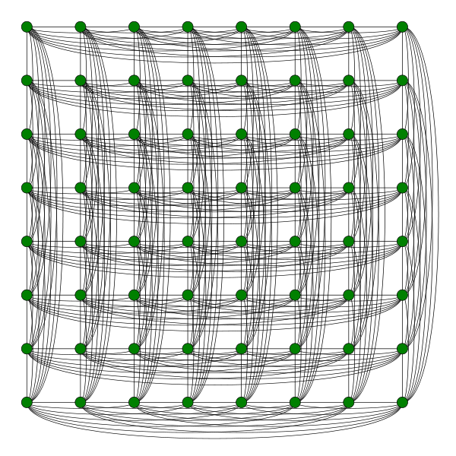
2.1. Hamming graphs
Complete graph: all-to-all connectivity (1d Hamming)
d-dimensional Hamming graph: Cartesian product of d Hamming graphs
Diameter k=d
Proposed for interconnections networks in [2, 3]
Congestion possible under adversarial traffic
Adaptive routing mechanisms: Select minimal or Valiant [7] routing
Deadlock freedom: Dimension ordered routing (path restriction)
[2] Kim, Dally, Abts, “Flattened butterfly: A cost-efficient topology for high-radix networks”, ISCA’07
[3] Ho Ahn et al, “HyperX: topology, routing, and packaging of efficient large-scale networks”, SC’09
[7] L. Valiant, “A scheme for fast parallel communication," SIAM journal on computing, vol. 11, p. 350, 1982.
Notes:
Grafo completo. Producto de grafos completes (uno por dimension). Diámetro igual al # dimensiones
Deadlock basado en DOR.
Nonminimal routing en caso de congestión (Valiant)

Slide 5
2.2 Dragonfly networks
Dragonfly [4]: Hierarchical direct network
More scalable than Hamming graphs
High scalability and low cost
Groups of routers connected between them
Local topology
Multiple groups connected
Global topology
Canonical dragonfly: the one with complete graphs in both local and global topologies
Diameter 3
Congestion under adversarial traffic
Nonminimal adaptive routing
Distance-based deadlock avoidance (several VCs required)
[4] Kim, Dally, Scott, Abts. Technology-Driven, Highly-Scalable Dragonfly Topology. ISCA '08
Notes:
Grafo basado en grupos
Local topology
Global topology
Distance-based deadlock avoidance
Nonminimal routing en caso de congestión (Valiant)

Slide 6
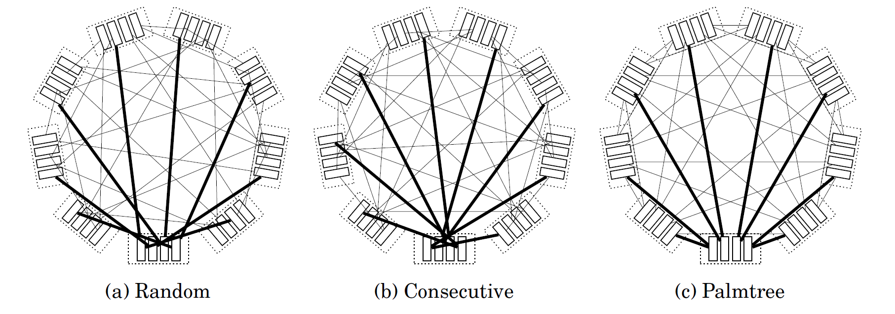
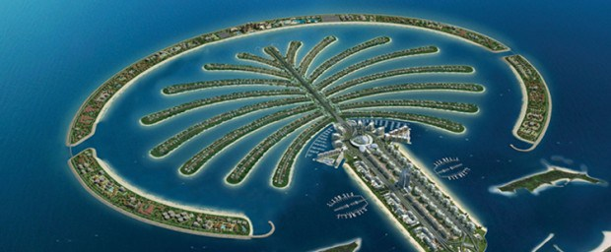
2.3 Global arrangements and trunking in dragonflies
Global link arrangement: which specific router within a group does each global link connect to.
Not a significant impact on performance, but…

Slide 7
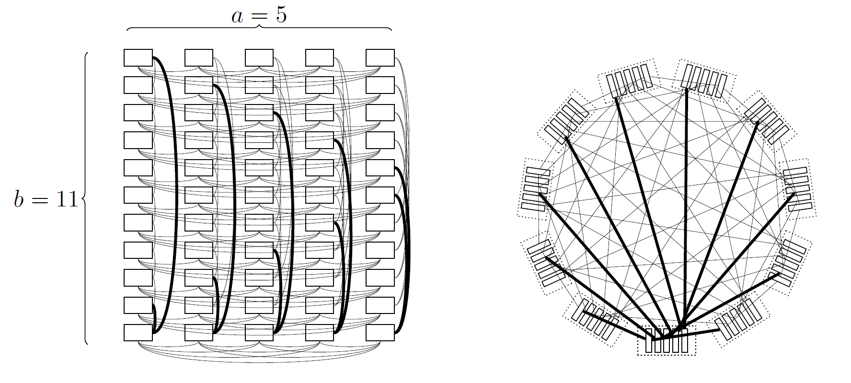
2.3 Global arrangements and trunking in dragonflies
Interesting arrangement: subgraph of the Hamming graph
Connections:
±1
±2
±3
±4
±5
±2
±3
±4
±5
±1
±3
±4
±5
±1
±2
Notes:
Show that a subgraph of the Hamming network can be a Dragonfly
Trunking – show different configurations with the palmtree
Hamming graph as a Dragonfly with trunking – progressively add more links to the original figure

Slide 8
2.3 Global arrangements and trunking in dragonflies
Trunking: Parallel links within a topology
Global trunking: parallel links in the global topology
Two or more global links between a pair of groups
With the proper global link arrangement, Hamming graphs are actually dragonflies with maximum trunking.
Trunking modifies the balancing conditions of the network
Balanced: a single resource does not become a bottleneck

Slide 9
Deadlock avoidance in Hamming & Dragonfly
Destin. node
Hamming: Dimension-ordered routing (DOR) requires:
Minimal routing: no VCs (1 buffer)
Valiant: 2 VCs
Dragonfly: Resource classes. Increase VC index on each hop
Minimal: 2 local, 1 global VCs
Valiant: 4 local, 2 global VCs
Path restrictions do not impose requirements in the router (number of buffers)
Dragonflies and Hamming graphs are part of the same family, so can path restrictions be used in Dragonflies?
Destin. router
Valiant router
Source router
Valiant router
Source node
Notes:
deadlock avoidance in Hamming relies on path restrictions
Traditional deadlock avoidance mechanisms in Dragonflies rely on VCs followed in an increasing order
But when you consider trunking, they are part of the same family!!
Is it possible to translate a path-restriction-based deadlock avoidance mechanism to a Dragonfly?
Answer: Yes, but only with certain global link arrangements and a mínimum trunking level

Slide 10
Index
Introduction
Topological characterization
Deadlock-free routing in dragonflies based on path restrictions
Minimal routing with trunking t ≥ 2
Nonminimal and adaptive routing with trunking t ≥ 4
Evaluation
Conclusions and future work

Slide 11
3.1 Deadlock-free Minimal routing in dragonflies with global trunking t ≥ 2
Link selection policy: depends on source and destination router colors
Red to blue:
Blue to red:
Red to red:
Increasing group index:
Decreasing group index:
Blue to blue: inverse colors
Dragonflies have cycles, which can block the network
Graph colorig:
Color each router using two colors (red/blue)
Use a global arrangement which only connects routers of the same color
Hamming subgraph
Palmtree
Color global links accordingly
Restrict paths to guarantee cycle avoidance
router
Group 3
group
l
g
l
l
g
l
l
g
l
Group 2
l
g
l
Group 1
Notes:
Al final de la transparencia, discutir que se emplean todos los enlaces por igual (simetría en rojo/azul)

Slide 12
3.1 Deadlock-free Nonminimal routing in dragonflies with global trunking t ≥ 4
Non-minimal (Valiant) paths go to an intermediate router to balance traffic
Proposed mechanism without virtual channels:
Assign to each router a color (red/blue) and parity (0/1): 4 combinations
Use a global connectivity pattern which only connects routers with the same color and parity (requires trunking t≥ 4)
Label global links according to {color}: 2 types of global links.
Label local links according to {source color, dest. color, parity change}: 8 types of local links.
Provide an ordering of links for all the possible paths:
The selection of the specific path depends on:
Color of source router (up: red, bottom: blue)
Color of destination router (up: red, bottom: blue)
Respective parity of source and destination router (up: no parity change, down: parity change)
Adaptive routing (Minimal/Valiant) can be implemented with this mechanism
Minimal: First or second half depending on color and parity of source and destination routers
No parity change
l₀
l₊₁
l₊₁
l₊₁
Source router color
g
g
Destinat. router color
l₀
l₀
l₊₁
l₀
Parity change

Slide 13
Index
Introduction
Topological characterization
Deadlock-free routing in dragonflies based on path restrictions
Evaluation
Conclusions

Slide 14
4. Evaluation
FSIN simulator [8] modified to model dragonflies with variable latencies and trunking t=4.
Uniform and adversarial traffic
Routing mechanisms:
Oblivious-VCs: Minimum, Valiant
Adaptive-VCs: In-transit adaptive OLM [9]
Color-based: 2-color, 4-color oblivious, 4-color adaptive
[8] Ridruejo and Miguel-Alonso.”INSEE: An Interconnection Network Simulation and Evaluation Environment. Euro-Par’05.
[9] García et al, “Efficient Routing Mechanisms for Dragonfly networks”, ICPP’13

Slide 15
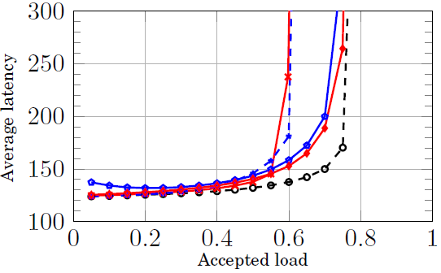
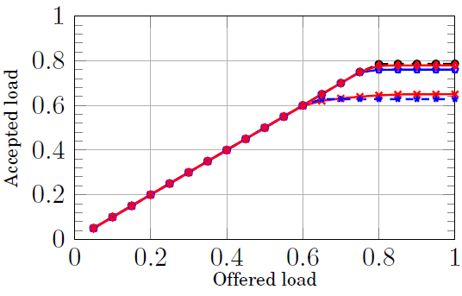
4. Evaluation – Random Uniform traffic

Slide 16
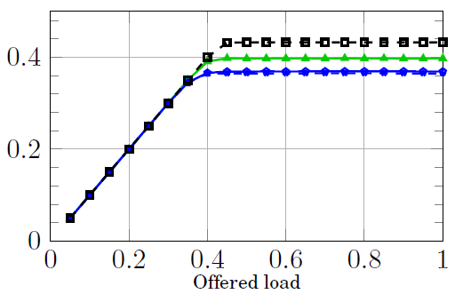
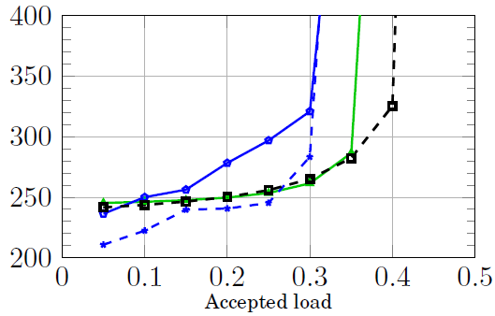
4. Evaluation – Adversarial traffic

Slide 17
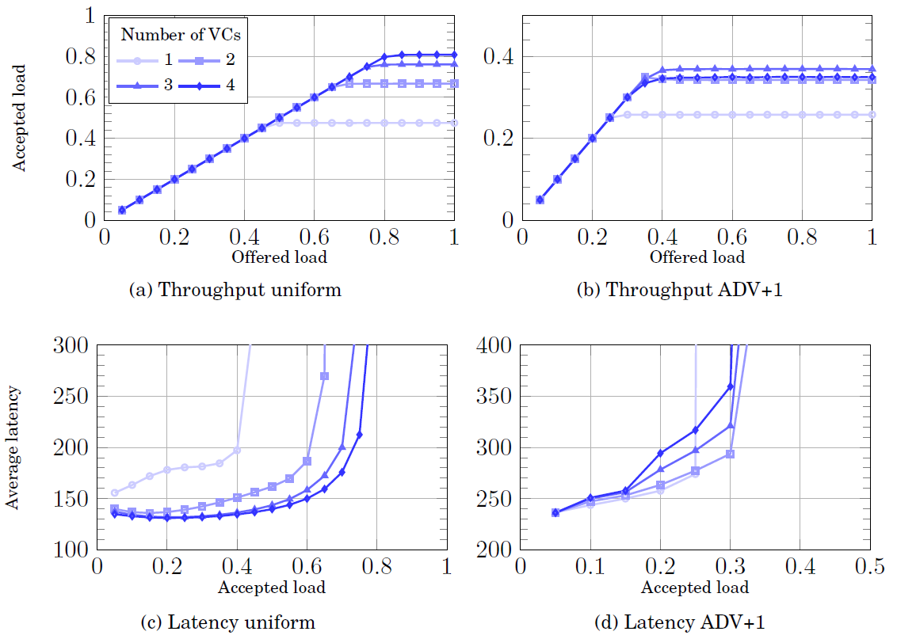
4. Evaluation – Number of VCs

Slide 18
Index
Introduction
Topological characterization
Deadlock-free routing in dragonflies based on path restrictions
Evaluation
Conclusions

Slide 19
5. Conclusions
We provided a topological characterization of Hamming and Dragonfly topologies.
With trunking, they are both part of the same family.
Global link arrangements are not significant for performance, but a careful selection allows for new deadlock avoidance mechanisms.
Deadlock-avoidance mechanism without virtual channels has been developed for Dragonflies with trunking
Supports minimal, Valiant and adaptive routing using trunking t≥4.
Competitive performance against VC-based with similar number of VCs, and permits implementations with lower cost.
We believe it could be especially useful for larger topologies with larger number of hops (3-level dragonflies) or those cases in which low router area is critical (on-chip fabric routers)

Slide 20
Topological Characterization of Hamming and Dragonfly Networks and its Implications on Routing
Cristóbal Camarero With support from:
Enrique Vallejo
Ramón Beivide
10th HiPEAC Conference – Amsterdam, January 2015.

